Slide 1


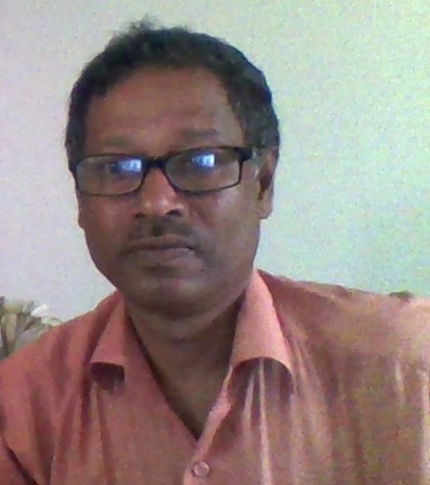



Dear students
Dear students
Welcome to my. Class

Slide 2


Introduction
Presented by
Nittya nondo Roy
Assistant teacher
English For Today
Class viiU# 4 L# 6
Time:- 40minutes
Chandamari B.l High School

Slide 3
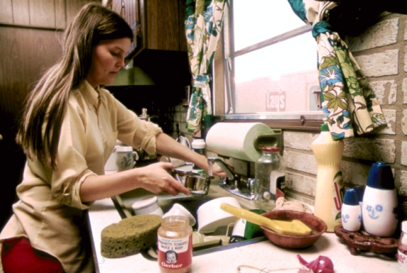
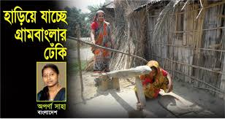
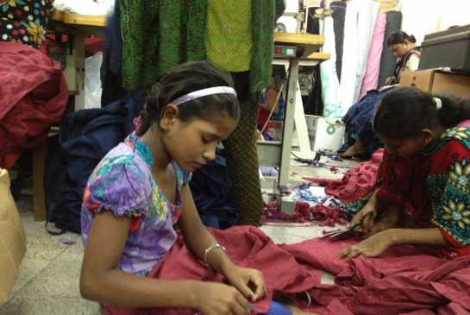
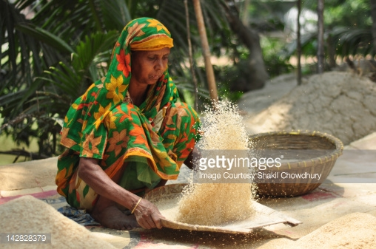
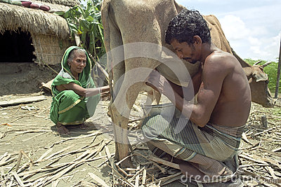
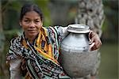
What kinds of works do you see in the pictures? Who are they?
weaving
husking
sewing
Cleaning
pottering
fetching
The pictures are household works. They are HOME MAKER.

Slide 4
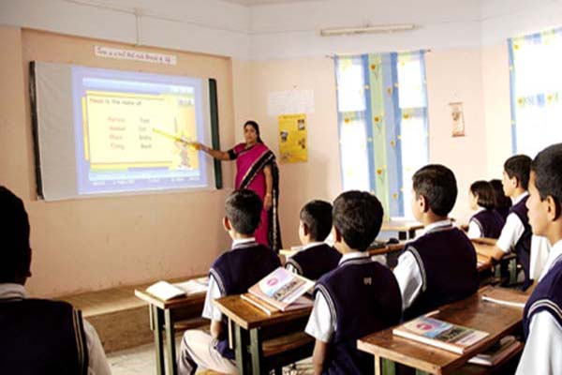

Our today’s lesson is
The Home maker (1)
UNIT # 4, Lesson #6, page #32

Slide 5
Aim of this content
AFTER THE END OF THE LESSON THE LEARNERS
WILL BE ABLE TO
1
Ask and answer questions
2
Read and understand the text
3
Talk about the people , place.
4
Read and write about people
5
Write paragraph
10/10/2017. EFT
Dated:-10/10/2017

Slide 6
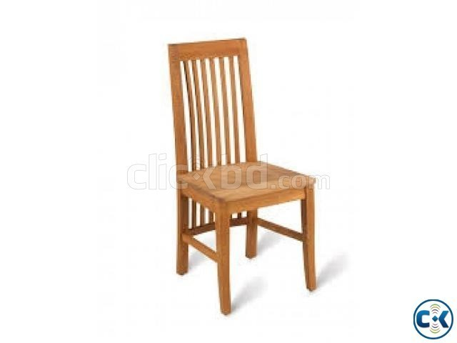
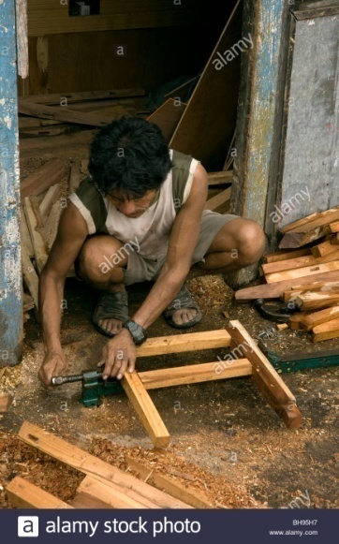
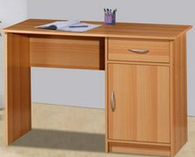
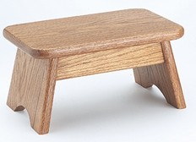
Look at the passage and read silently
Mrs Nazma and Mr Joynal Ali live in a small village with their daughters, Mitu aged 7 and Nitu aged 5. Joynal is a
. He is hired by the villagers to make , , . and other furniture. He is also asked to do small repair work. But Joynal does not find work every day . He lives from hand to mouth .
carpenter
Chairs
tables
pira

Slide 7
Nazma does all the works at home from morning to night ,rain or shine . Sometimes she sits with Mitu and Nitu and them Bangla and English and some
They do not go to school . Nazma could only up to class 5 . Joynal is illiterate.
teaches
alphabets
Numbers
study

Slide 8
Nazma’s daily works in her house
Making bamboo wall
Cooks for family
Caring baby
Wash cloths
Teaches her children
Carrying fire wood
Husking paddy
Collecting water

Slide 9
Joinal Ali does for his family
Does as carpentry
Buys food for family

Slide 10

Let’s Search difficult words

Slide 11
Who makes
wooden furniture
carpenter
The carpenter makes wooden tools.
Low stool
Pira
Poor women use pira in her house
Living being poor state
Hand to mouth
Poor people lives from hand to mouth

Slide 12

The person who does not know how to read or write
illiterate
60% percent people of our country are illiterate.
Rain or shine
In good or bad weather

Slide 13
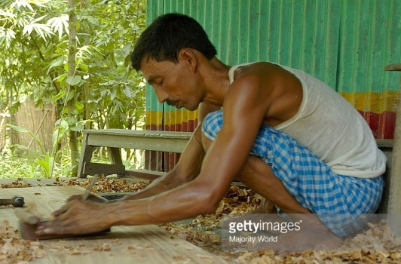
Pair works 5 minutes activities
Make two list of what Nazma and Joinal do in their house
Joina ‘s activities | Nazma’s activities
Makes tools ----- ------ | Cooks ------ -------

Slide 14
Indivisual works 5 minutes
Match the phrase /word with their meaning and make sentences
Phrase/words | meaning
Rain and shine | Female child
alphabet | A person who does not know how to read or write
illiterate | Spend all the money your earn on basic need , e.g. food, cloths-- can not save money
Live from hand to mouth | In bad or good weather
daughter | All the letters in a language

Slide 15
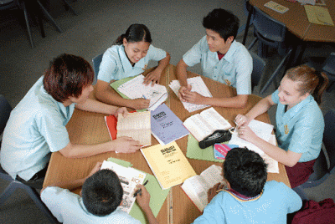
Group works 5 minutes
What do you think is the reason why Mitu and Nitu do not go to school?

Slide 16
Grammar discussion and further open works
Present indefinite tense
Subject 3rd person
Mrs Nazma and Mr Joynal Ali in a small village.
live
plural Number
Present indefinite tense
Subject 3rd person singular Number
Mrs Nazma her children.
teaches
Structure of present indefinite tense:
S₃₁+V₁+s/es/ies +Object
S₁₂+V₁+Object
Now pick out another sentences from the text .

Slide 17
Feedback of the students.
Answer the following questions
1
Who is Joynal Ali?
2
Who were his children?
3
Who is Mrs Nazma ?
4
Why Mitu and Nitu do not go to school?
5
What things does Nazma teach to her children?
Joina Ali is carpenter.
Mitu and Nitu were their children
Nazma is homemaker.
They are poor and their father is illiterate.
Nazma teaches alphabet and numbers to her children.

Slide 18

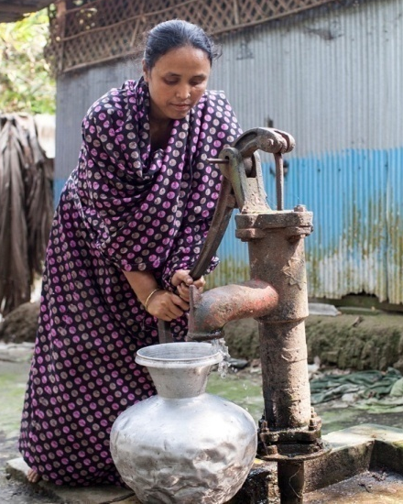
Home work
Cox’s Bazar Pre Cadet Model High School.
Write a short note on
Nazma’s Family

Slide 19
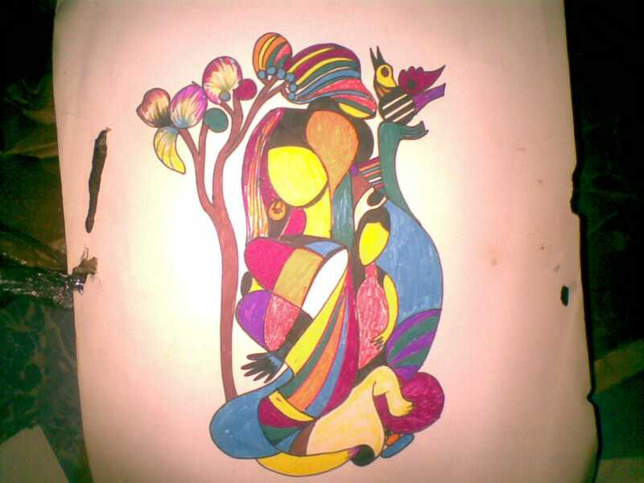

Thanks again.Bye
See you again
next class

